Slide 1


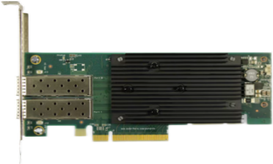
AMD Solarflare X2522-10/25GbE
Low Latency Ethernet Adapter
上海赋缘汇实业有限公司 —www.fableshare.cn—
General Specifications
Host Interface | PCIe 3.1 x8
Media Connectivity | SFP28
Form Factor | PCIe® Low Profile, MD2
Networking Capabilities | Stateless Offloads SR-IOV Interrupt Coalescing Intelligent Auto-Negotiation Hardware Timestamping
Network Acceleration | AMD Solarflare Onload™ software - TCP/UDP TCPDirect* - TCP/UDP
SKUs | X2522-25G X2522-25G-PLUS

