Slide 1


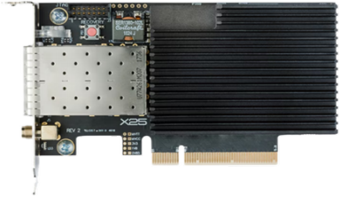
Cisco Nexus K3P-S FPGA
SmartNIC Data Sheet
上海赋缘汇实业有限公司 —www.fableshare.cn—
General
Form factor | Low-profile PCI Express Card 117x68mm (4.65x2.67in)
Environmental | Operating temperature: 0 °C to 55 °C Storage temperature: -40 °C to 70 °C Operating Relative Humidity: 5% to 90 % (non-condensing) Storage Relative Humidity: 5% to 95% (non-condensing)
Recovery | Manual firmware recovery button
Ports | 2x SFP28 SMA for PPS in/out
Data rates | 25GbE, 10GbE, 1GbE, 100M Fast Ethernet
Supported media | Fiber (25GBASE-SR, 25GBASE-LR, 25GBASE-CR), SFP(+/28) Direct Attach
Host interface | PCIe x8 Gen 3 @ 8.0 GT/s per lane

